Slide 1

Internet safety
Z:\CAC\Training & Education\Online Safety
Helping CHILDREN stay safe online – an overview
Teri York Brown
Chemung County Child Advocacy Center
Community Education & Awareness Coordinator

Slide 2

Today’s agenda
Typical Uses & Access
The ‘Other’ Talk
The Numbers
Bullying and Cyberbullying
Grooming
Parental Control Options
Online Dating
Help and Resources

Slide 3





WHAT WE DO AND HOW WE DO IT
Social Media
TV/Networks
Professional Tools
Entertain-ment
Gaming/Apps
Xbox
PlayStation
Fortnite
Call of Duty
Roblox
Minecraft
Personal Computers
Smart TV’s
Live TV
Netflix
Alexa/Siri
Amazon
Cell Phones
Facebook
Snapchat
Instagram
WhatsApp
Twitter
Discord
Provided Devices
Presentations
Search Engines
Email/Messenger
Webinars
Zoom/Teams
TikTok
Spodify
Pandora
Amazon
Tinder/Grindr
YouTube

Slide 4
* Every Second, 5,700 Tweets are posted, and 4,600 Snaps are sent
* Over Ninety Percent of youth who are abused know and trust their offender
* Only about One Half of youth in a relationship can identify abusive behaviors
* Sixty Eight Percent of rape victims know their assailant (or think they do)
* By age 13, most American youth have watched pornography
* Most American Children know what sex is by Age 9
*Remember to obtain permission before posting about them online to ensure they understand privacy and respect.
What The numbers say
* The FBI is so overwhelmed by child sexual image reports that they must prioritize by age, often focusing on Infants and Toddler Cases.

Slide 5

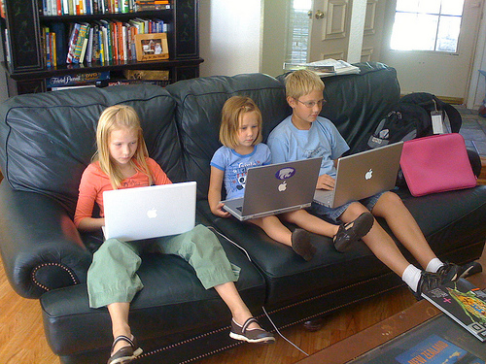
Think about it this way…
Many Of Us Went To The Mall To Hang Out With Friends And Meet New People
Now Kids Go To The Virtual World To Find Friends And Forge New Connections

Slide 6

Digital safety basics – “the other talk”
Location! Location! Location!
Participation & Presence
Rules & Boundaries
Consequences
Check Yourself
Red & Yellow Flags
Use Written Contracts

Slide 7
Eating Disorders
Peer Pressure
Dating Violence
Slavery
example
Stalking
Drugs
Pornography
Weapons
Blackmail
Sexual Abuse
Sexual Assault
Manipulation
Isolation
Body Image Issues
Gangs
Cults
Runaways
Child
Exploitation
Body Image Issues
Alcohol
Cyberbullying
Self Harm
Human Trafficking
Harassment
Kidnapping
Suicide
Theft
Sex Acts
Threats

Slide 8

Talk to kids about their activities
Ask Early, Ask Often and Normalize Supervision.
  What app/site/game are you on?
  What level are you on? What’s this character do?
  Who do you follow/message/chat with?
  What else do you talk about?
  What if a stranger contacts you?
  What if someone makes you uncomfortable?
Ensure They Know It’s About Their Safety!

Slide 9

Things to never
DISCUSS ONLINE
Real Life
Location
(Geotagging)
Family
Orientation
Bullying
Explicit
Name/AgeDOB
Device GPS
Relatives’
Names
LGBTQIA+
Hate Speech
Porn or Sexual Acts
Phone Number
Check-in’s
Home Address
Religious
Beliefs
Threats
Drugs or Alcohol
School/
Mascot
Vacation Info
Pet Names
Feelings/
Emotions
Violence
Gang Activities

Slide 10
Is it Rude, Mean, or Bullying
Rude
Usually an unplanned, thoughtless comment
Often rooted in ignorance or lack of respect for other’s feelings
Not meant to hurt someone
Mean
Spontaneous or poorly thought out
Driven by anger and/or to put another person down
Aims to hurt someone else
Bullying
Intentional, aggressive acts that are repeated
Involves power imbalance, bully feels need to assert self over the victim
Intentionally hurting others, no regret or remorse no matter what victim’s response is

Slide 11
cyberbullying
  Repeated, aggressive, hurtful, threatening, or offensive texts, emails, DMs, comments, posts on social media or the web where there is a clear aggressor and target
  May be an individual or group(s) of kids harassing someone together (aka “brigading”)
Time and Location Mean Nothing
  Access to Devices
  Apps, Social Media, Chat Rooms, Emails
Anonymous and Impersonal
  Harassment/Ghosting
  Masquerading/Doxing/Trolling

Slide 12
“What’s the big deal?:” possible consequences
Embarrassment
Physical Injury
Criminal Charges
Self-Harm
Sexual Abuse or Assault
Trauma/PTSD
Disciplinary Actions
Ruined Reputation
Sexual Exploitation/Trafficking
Military Ineligibility
Lost Scholarships/Trade Schools
Suicide

Slide 13

GROOMING: PREDATORS’ PLANNING
STAGE 3: Fill a Need
STAGE 4: Isolate the Child
STAGE 2: Gain the Victim’s Trust
STAGE 5: Sexualize the Relationship
STAGE 1: Target the Victim
STAGE 6: Maintain Control
Source: https://healingfromcomplextraumaandptsd.wordpress.com/author/healingfromcomplextraumaandptsd/

Slide 14

ONLINE GROOMING: GROWING A VICTIM
The abuser is planting a seed in a child’s mind and wants to make it grow their way...
They make a child feel comfort and trust, then gradually become inappropriate: dirty jokes, adult topics, porn, to taking pictures, and/or sending videos. The offender now has what they need to manipulate, entice, or coerce the child to send more content, maybe meet in real life or bring in others to the ‘family’…
The child thinks this perpetrator loves them. Now they’re a victim without having any idea that’s what happened until it’s too late…
The offender makes sure the victim won’t tell anyone or won’t be charged if they do tell…

Slide 15















what to be concerned about
The above is based on research & information gathered about parental controls and child safety. See “Citations” & “Resources.”

Slide 16
Common Abbreviations
AITR: Adult In The Room
PIR: Parent in Room
P911/CD9: Code 9/Parent Watching
MOS/DOS/SOS: Mom/Dad/Someone Over Shoulder
SPECIAL K: Hallucinogens
ANTIFREEZE: Heroin
NIFOC: Naked In Front of Computer
IWSN: I Want Sex Now
S2R: Send To Receive (pictures/video)
Dexing/Triple C: Abusing cold medication
ASL(RP): Age Sex Location (Race/Picture)
TDTM: Talk Dirty To Me
MIRL or LMIRL: (Lets) Meet In Real Life
CRUNK: High and Drunk Simultaneously
CRANK/ICE: Crystal Meth
GYPO: Get Your Pants Off

Slide 17
Online dating
(many apps/sites say they don’t allow minors)
It’s important to explore why the youth is using online dating options:
Are they pretending to be someone else? (LGBTQIA+, lying about age, etc.)
Is there ulterior motivation? (money, lodging, personal items, etc.)
Are they seeking validation or attention from strangers? (sad, depressed, lonely, isolating)
Is this a YPSB*?
Are they genuinely looking for love online with older people?
Does this youth have disabilities? (more vulnerable/naïve, trusting)
*Youth with Problematic Sexual Behaviors

Slide 18
So, what do you say?
“Unfortunately, not everyone online has good intentions”.
  Per NSPCC*, over 200,000 secondary school kids have been groomed online.
  1 in 8 American youth has been solicited for sexual favors online.
“Sometimes kids are tempted to send explicit or nude photos, but it’s not always safe”.
  These photos or videos may become public or get posted and shared.
  The receiver may use that info or image against you later to force, threaten or coerce you into sending more or maybe even worse.
“No matter what, even if you think I’ll be mad, you can come to me, and we’ll deal with it together.”
Sometimes kids need to hear a loved one say they’re not mad at them, but at the situation or the person who made the child upset or unsafe and that it’s ok to tell.
*UK’s National Society for Prevention of Cruelty to Children

Slide 19



What we’re CONCERNED ABOUT
Hily – Free dating app youth are using but it’s supposed to be adult only.
2021 Top 10 Dating App

Slide 20
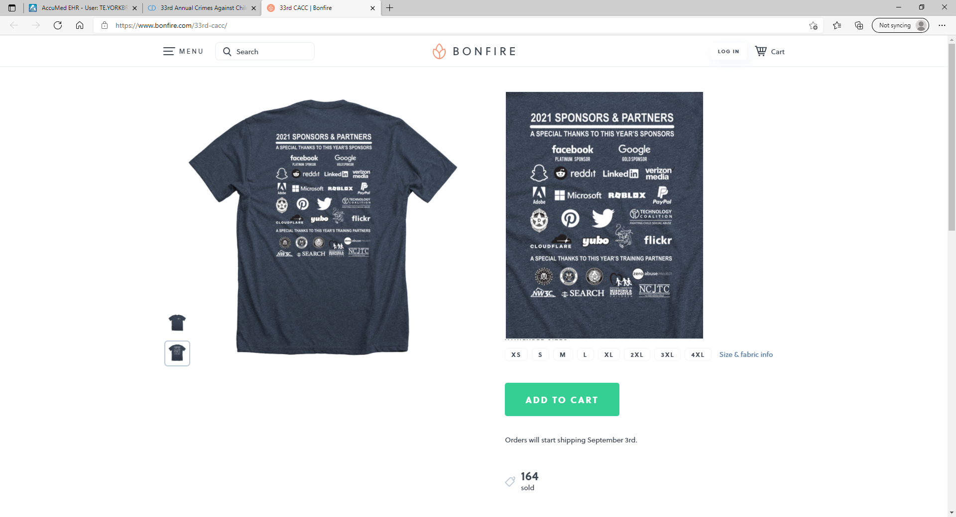
Smart marketing

Slide 21
Discord: Go to User Settings -> Privacy -> Safety Options and check the ‘Keep Me Safe' box to block the unrelated content.
INSTAGRAM: Tap The Profile Button (For iProducts) Or The 3 Vertical Dots (For Android). Select -> Account Privacy -> Private Account. Slide Indicator To The Right And It Will Turn Blue Once It’s Private.
SNAPCHAT: Go to Profile -> Settings At Upper Right Corner. Scroll Down To The 'Who Can…' Section -> View My Story -> ‘My Friends’.
PARENTAL CONTROL SETTINGS
*Is your kiddo unclicking your settings? *Is the child accepting all friend requests?

Slide 22
TikTok
To set your account to “Private:” Click the three-dot icon -> Privacy and Safety -> “ON” position. In the Privacy and Safety screen: Click “who can comment on your videos”. Under Privacy and Safety: click Comment Filters -> Filter Spam and Offensive Comments -> “ON” position.
TikTok also allows you to Block Users: Click Their Profile -> Settings -> Block.
TikTok has options called “Digital Wellbeing.” Click Profile -> Settings -> Digital Wellbeing. From there, screen time can also be limited.
*Passcodes are implemented to ensure your child isn’t resetting the safety options!

Slide 23
Parental settings for other apps
TWITTER:
  From profile, go to Menu -> Settings and Privacy -> Privacy and Safety. Select ‘Protect your Tweets.’ Only followers and approved people can see tweets once that’s selected.
  Photo Tagging: Tap the text to bring up the menu and set this to ‘Only people you follow can tag you’.
  Direct Messages: Tap the text to bring up the menu ‘Receive Message Requests’ and only people you follow can send DM’s via blocking messages.
  Live Video: Deselect this function or your child will get live streams.
  Discoverability and Contacts: Phone numbers and email addresses can be pinged if you don’t disable this function.
  General Safety: Disallow ‘Display media that may contain sensitive content.’ You can also manage the blocked, muted lists and people or content from that section.
  To block a person: Go to their Twitter profile -> click on the three buttons on the top of the screen -> ‘Block’

Slide 24
Parental setting for other apps, cont.
FACEBOOK:
  From the home screen, click three lines in lower right corner, then tap Settings & Privacy -> Privacy Shortcut. Review and manage the Privacy Settings from there.
  To set a time limit or monitor how your child spends time on Facebook: From the Home Screen, click three lines in lower right corner, then tap Settings & Privacy -> Your Time on Facebook -> Manage Your Time -> See Tools. From here, you can schedule quiet mode, daily reminders, and monitor usage.
WHAT’S APP:
  Settings -> Account -> Privacy (or then Groups). Change and save desired options.
  To deactivate location, in device Settings ->WhatsApp -> Location. Select Never or Ask Next Time. Check to ensure location is off, Settings -> Account -> Privacy -> Live Location.

Slide 25


Gaming options
FORTNITE
Setting to ‘solo mode’ is the only way to prevent outside contact.
Chatting cannot be disabled; there are no filters for voice or text. Anyone can contact younger players.
Menu -> Parental Controls. You’ll have to add an email and PIN. From there, parental controls can disable video chats, mature language, friend requests, multi-player, etc.
ROBLOX
But there are NO parental controls aside from turning off the chatting functions.
Anyone can contact others via messages, chats, or live functions if chat is enabled.
Disabling Chat: Log in -> click Settings -> Privacy -> Contact Settings -> Select “No one.”
MINECRAFT
Setting ‘single-player mode’ is the only way to avoid interaction with other players.
Minecraft has server moderators to prevent it, but youth may still be exposed to strong language, bullying, and predators.
There have been issues with sexual scenarios and mature content.
Simply set Single Player Mode

Slide 26

Parental control software options
Life360: (Sometimes FREE Trial or $99/year for cheapest plan).
  Highest rated Android app.
  Includes real-time location tracking, roadside assistance for basic plan
  SOS help alerts, and data breach alert, not sexual content.
  No content monitoring for emails, apps, chats, social media.
Kaspersky Plus: (FREE for basic or $15/year)
  Rated highly for ease of use, compatibility with other programs or apps (you can have multiple privacy and/or controls setup) and tech options. Web searches, email, location and social media content can all be monitored and/or limited by administrator.
  Price goes up with each additional device you add to the plan. VPNs are difficult to track on Mac.
Bark: (FREE Trial, $10/month or $99/year; or $50/mo. for Bark phone with controls built in)
  Rated highest for content management and monitoring screentime for over 30 apps, platforms, emails, texts, etc. Screens for suicidal ideations and cyberbullying. Bark also posts location and check in info to parent/guardian and uses algorithms to monitor.
  Complaints include connection issues across different operating systems, general incompatibility with apps they said were protected, poor customer service, phone updates causing setting resets, and hidden fees. It’s also not available for desktops.
The Child Advocacy Center is not endorsing any of these programs. The purpose is to provide additional information and/or resources.

Slide 27

Parental control software options, con’t.
Norton Family: ($5/month or more)
  Allows for filtering adult content, location monitoring and gaming or streaming oversight and has relatively simple setup and usage.
  Does not work with Mac and blocking games or apps can be easily undone/reset every time someone logs into the iOS device. Parental alerts are said to be limited.
Qustodio: (FREE Trial with Free Features or from $55/year)
  Web filters, reporting, time limits and filters, are all options on the free plan after the free trial is up.
  The paid version allows for monitoring of multiple devices.
  Free version is limited to a single device.
The Child Advocacy Center is not endorsing any of these programs. The purpose is to provide additional information and/or resources.

Slide 28
Did you know……?
Did you know your kid can reset the Time Zone and get a couple more hours of screentime every day??
Did you know Siri and Alexa don’t care about your parental controls??
Did you know your kid can reset their iPhone and just log back in to cancel restrictions??
Did you know that Social Media use has greatly impacted young people’s (esp. female’s) perceptions about sex and relationships, mental health, triggered eating disorders or negative self-image??
Did you know that your kid possibly thinks you’re addicted to your phone??
Notes:
4/10 kids surveyed in 2019 said their parents spent more time online than parenting and they’re addicted to their devices.

Slide 29
NEXT STEPS: if something happens
Do’s:
Stay Calm & Listen
Thank & Believe Them
Report/Block/Delete
Screenshots/Copy Evidence
Answer Questions Honestly
Call Professionals for Help
Do Not’s:
Panic, Yell or Flip Out
Use Rapid Fire Questions
Get Dramatic or Overreact
Blame or Shame Them
Share/Repost Any Evidence
Tell Child What’s Going to Happen

Slide 30
Citations
https://www.psychologytoday.com/us/basics/sexual-abuse
https://www.ofcom.org.uk/tv-radio-and-on-demand/advice-for-consumers/television/protecting-children/advice-guides-for-parents/parental-controls-for-games-consoles
https://www.fatherly.com/parenting/how-to-talk-about-internet-safety-with-kids/
https://www.thetoptens.com/dangerous-social-media-apps/
https://www.psychologytoday.com/us/basics/sexual-abuse
https://www.childline.org.uk/info-advice/bullying-abuse-safety/online-mobile-safety/online-grooming/
https://www.nextiva.com/blog/benefits-of-event-sponsorship.html#s3
https://www.kbsolutions.com/Grooming
https://healingfromcomplextraumaandptsd.wordpress.com/author/healingfromcomplextraumaandptsd/
https://clario.co/blog/which-company-uses-most-data/
Top 7 Best Parental Control Apps for Desktop and Phone (2023) (vpnoverview.com)
https://www.digitalmomblog.com/social-media-and-teens/
https://www.youtube.com/watch?v=8iTPPh1d2j8; Protect Yourself Rules - Safe Touch / Unsafe Touch – YouTube (Wonder Kids)
https://softwarelab.org/kaspersky-antivirus-review/
https://www.pcmag.com/reviews/norton-family
https://www.internetmatters.org/resources/teens-and-online-dating-advice-hub-for-parents/online-dating-the-risks-for-teens/

Slide 31
Citations, con’t
Are Yohttps://www.nytimes.com/2019/05/30/learning/are-your-parents-addicted-to-their-phones.html#:~:text=Today%2C%20about%20four%20in%2010%20teenagers%20believe%20their,children%20spend%20too%20much%20time%20on%20the%20devices.ur Parents Addicted to Their Phones? - The New York Times (nytimes.com)
https://kidsnclicks.com/4-ways-kids-bypass-iphone-parental-control-system/
https://www.eatingdisorderhope.com/blog/body-image-technology
The Difference Between Rude, Mean, and Bullyhttps://www.bark.us/blog/how-cyberbullying-is-different/#:~:text=%20Traditional%20Bullying%20vs.%20Cyberbullying%20%201%20Time,to%20be%20destructive%20forms%20of%20social...%20More%20ing (intermountainhealthcare.org)
Traditional Bullying vs. CybeTraditional Bullying vs. Cyhttps://www.bark.us/blog/how-cyberbullying-is-different/#:~:text=%20Traditional%20Bullying%20vs.%20Cyberbullying%20%201%20Time,to%20be%20destructive%20forms%20of%20social...%20More%20berbullying - Barkrbullying – Bark
Hily Dating App Review in 2021: FeatureHily Dating App Review in 2021: Features, Pros, Cons - RomanceScams.orgs, Pros, Cons - Rohttps://www.romancescams.org/hily-dating-review/#:~:text=Hily%20is%20a%20free%20dating%20app%2C%20allowing%20its,perks%2C%20such%20as%20profile%20boosts%20and%20chat%20requests.manceScams.org
https://www.smartgensociety.org/resources/parents
https://kidlogger.net/features.html
https://www.verywellfamily.com/startling-facts-about-todays-teenagers-2608914
https://www.usatoday.com/story/opinion/2023/03/10/how-social-media-emboldens-abusers/11413209002/
https://www.bark.us/learn/ps-bark-vs-mspy-lp/?msclkid=6a77e9b5b57c12d5eb248de6726e60b8&utm_source=bing&utm_medium=cpc&utm_campaign=Search%20US%20%7C%20Competitors&utm_term=how%20mspy&utm_content=mSpy
https://www.bark.us/learn/ps-bark-vs-norton-lp/?msclkid=6a77e9b5b57c12d5eb248de6726e60b8&utm_source=bing&utm_medium=cpc&utm_campaign=Search%20US%20%7C%20Competitors&utm_term=how%20mspy&utm_content=mSpy

Slide 32
Citations, con’t.
https://parents.thorn.org/?msclkid=5cd008fc2a6a1272e47e6ca120a1062a&utm_source=bing&utm_medium=cpc&utm_campaign=Thorn%20for%20Parents&utm_term=Internet%20safety%20for%20parents&utm_content=Child%20Internet%20Safety
https://www.top10.com/parental-control/comparison?bkw=free%20parental%20control%20apps&bcampid=370590289&bcamp=Parental%20control%20US%20Bing%20tCPA&bagid=1178677386642630&bag=Free&btarid=kwd-73667494305059:loc-4116&bidm=be&bnet=o&bd=c&bmobval=0&bt=search&utm_source=bing&utm_medium=cpc&utm_term=free%20parental%20control%20apps&utm_campaign=Bing+CPC+Campaign&c=73667571461774&m=e&k=73667494305059&binterest=&bphysical=102648&bfeedid=&a=B6008&ts=&topic=&upf=&clicktype=&msclkid=6bd2394a03e91a70cdad5d16f7abc853
https://www.safetydetectives.com/blog/best-really-free-parental-control-apps/

Slide 33
Resources - Chemung
CPS: 607-737-5417 (Chemung Intake)
NYS Hotline: 1-800-342-3720
Police/Ambulance: 911
EPD Victim’s Advocate: 607-737-5800
Chemung DV Hotline: 607-732-1979
Teen Line: Text TEEN to 839863 or 1-800-852-8336
Trans Suicide/Lifeline: 877-565-8860
OVS: OVS@jud.ct.gov or 1-800-822-8428
NCMEC: CyberTipline.org or 1-800-THE-LOST
SSS: 1-888-810-0093 (formerly SARC)
CRISIS: 607-442-6900
CIDS: 607-733-6533
CIS: 607-737-5582
CAC: 607-737-8449

Slide 34

Teri York Brown
Chemung/Schuyler Child Advocacy Center
Community Education & Awareness Coordinator
304 Hoffman Street, Elmira NY 14905
320 W. Main St., Montour Falls, NY 14865
607-737-8449
Thank you for your time!!

Slide 35

Teri York Brown
Chemung County Child Advocacy Center
Community Education & Awareness Coordinator
304 Hoffman Street, Elmira NY 14905
607-737-8449
Questions?
Comments?
Thank you for your time!!

