Slide 1
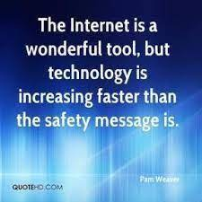
INTERNET SAFETY
David Ryan, Chief of Police (retired)
Coordinator / Westchester Anti-Trafficking Task Force
Director / Westchester County DV High Risk Team
Consultant / International Organization for Adolescents
Consultant / Montclair University Global Center on Human Trafficking

Slide 2
David M. Ryan, Chief of Police (retired)
Coordinator / WCATTF
Director / WCDVHRT
Pound Ridge Police Department
40 year career in Law Enforcement
Co-Founder / Coordinator Westchester County Anti-Trafficking Task Force
Director Westchester County Domestic Violence High Risk Team
LETTAC Human Trafficking Instructor through OVW IIR
Former Chair WCPCA DV Committee
Former Westchester Chief’s Association Representative Westchester County DV Council
Advisory Council Member, Pace Women’s Justice Center Friends of Gail
Advisory Board Member, Hope’s Door
Vice President / Board of Directors, New Dawn Family Resource Center
Co-Founder Northeast Westchester Domestic Abuse Alliance
Cell (917) 559-8542
E-mail: DRyan@iofa.org

Slide 3
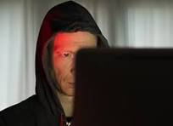
https://www.youtube.com/watch?v=UKFsBx8XE4M&list=PPSV

Slide 4
Home Safety
Do you have cameras?
Do you have an alarm system?
Do you have panic buttons?
Do you have locks on doors and windows?
Do you let total strangers walk into your house anytime they choose?
Do you lock your car doors?
Do you protect your children out in public from strangers?
Do you teach your children Never Talk To Strangers?

Slide 5
WHEN YOU CONNECT TO THE INTERNET
YOU CONNECT TO THE CYBER-WORLD
YOU INVITE IN TOTAL STRANGERS
YOU, YOUR CHILDREN AND YOUR PROPERTY ARE VULNERABLE
THE UNINTENDED AND THE UNKNOWN CAN BE DEADLY

Slide 6
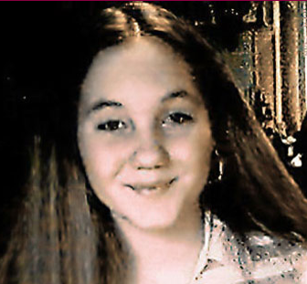


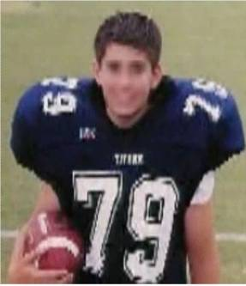
Predators will use information obtained from children to gain trust and friendship (her mother’s death).
Unless you know someone in person, you don’t really know who they are on the Internet (predator portrayed himself as 18 yr old).
Anyone is vulnerable (father was police officer, lived in small town).
6
Notes:
Kacie Rene Woody was a typical 13-year-old girl. She was a good student, a member of the school band and liked going online. Kacie met 18 year old David Fagan in a Christian chat room for teens. She didn’t doubt his identity because the picture posted in David’s profile was of a brown hair, blue eye teenage boy. What Kacie didn’t know was that David Fagan didn’t really exist.
(Click mouse) She was really talking to 47 year old David Fuller. He had used a photo of a nephew in his profile. Fuller was an Internet predator who had set his sights on Kacie. She made the fatal mistake of sharing personal information with him. Fuller tracked Kacie from his home in San Diego, California to the small town in Arkansas where she lived. He abducted and then killed her before committing suicide.
This is a tragic story and we should all learn something from such a tragedy.
(Click mouse)
Predators will use information obtained from children to gain trust and friendship - When Kacie told Fuller about witnessing her mother’s death in a traffic accident, Fuller told Kacie that he had an aunt that lived in Arkansas who had also been in a traffic accident, was in a coma and expected to die soon. This is one way he established a bond of trust and friendship.
Unless you know someone in person, you don’t really know who they are on the Internet. Fuller portrayed himself as 18 years old and Kacie believed him.
Anyone is vulnerable - Kacie’s father was a police officer and she lived in small town, but once she logged onto the world wide web, she was no longer just a part of the small community she physically lived in.

Slide 7

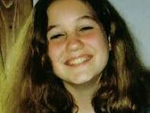
Kacie Rene Woody was 13 years old when she was lured, abducted and murdered by 47 year old David Leslie Fuller
Kacie Rene Woody thought she was meeting a 17 year old football player named David Fagen from San Diego.
Kacie's case is possibly the first well-documented case of a pedophile using the Internet to groom, abduct, and murder a victim

Slide 8

Sexting
Videos
Twitter
Photos
IM
Text
MySpace
Facebook
Notes:
It is important for children to be careful about the types of text messages, pictures and videos they send over their cell phone. The consequences of sending sexually explicit messages or images can be staggering. Many kids can end up being the target of bullying, harassment and some can even face criminal charges.
Sexting is the sending of sexual messages, pictures, or videos through cell phones. Sometimes sexting is considered child pornography, which is a crime. Even teenagers can be registered as sex offenders for sexting.

Slide 9
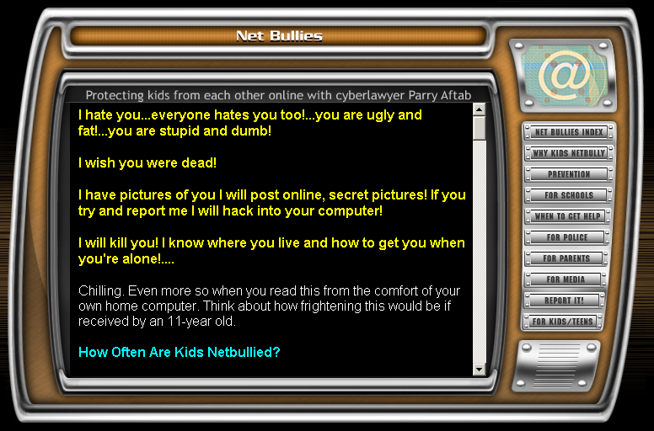
“Cyberbullying” - Any Device, Anytime…
IT NEVER EVER ENDS
Notes:
Cyberbullying has rapidly become a problem that is difficult to deal with. Technology now allows for bullying at any time, any place.

Slide 10

Teens Charged in Fatal Cyberbullying Case of Rebecca Sedwick to Remain in Jail– the two girls arrested were under the age of 15
Police on Monday arrested two girls, ages 14 and 12, in connection with the death of Rebecca Sedwick, who jumped from the top of an abandoned concrete plant last month.
Both physical stalking and cyberstalking are prohibited in New York, and alleged offenders can face serious criminal charges that carry steep penalties. If an alleged offense resulted in injury to an alleged victim, the crime becomes a felony offense.

Slide 11

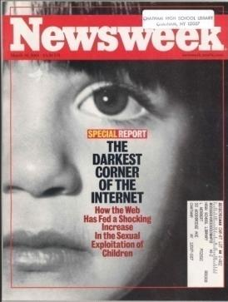
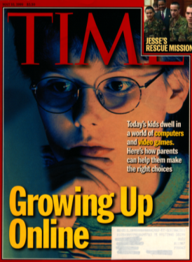
FOOD FOR THOUGHT FOR PARENTS
You must decide your strategy.
Some material may be “unsettling,” but this is unavoidable.
Instill a sense of caution, not a sense of fear.
The good does outweigh the bad.
Ask questions … offer thoughts.
Notes:
Children need instruction and rules throughout life – including using the Internet. We don’t just give our children keys to the car when they are old enough to drive – they receive lessons and learn the rules of the road. The same is true when traveling the information highway – the Internet. Children need instruction and rules in order to proceed safely.
Rules and safety tips are some of the topics we will be addressing.

Slide 12
Everyone
Never upload (post) pictures of yourself onto the Internet or on-line service to people you do not personally know and NEVER upload explicit photos.
Never post vacation plans online. EX: (Status: Leaving tomorrow for a 7 day cruise!)
Never download pictures from an unknown source, as there is a good chance there could be sexually explicit images.
Never respond to messages or bulletin board postings that are suggestive, obscene, belligerent, or harassing.
Never use images or messages that are hurtful or insulting to others. •
Never arrange a face-to-face meeting with someone you met on- line. NO MATTER WHAT!
AND BY THE WAY
What you put out there may be out there forever.
Hmmmm……will this impact my college application?
Hmmmm……will this impact my future employment?
Hmmmm……will this impact my current employment?

Slide 13
Parents
Be a Parent
Establish clear limits
Periodically check postings and websites
Maintain an open dialogue with kids
BE AWARE OF GAMING ON-LINE WITH YOUNG CHILDREN

Slide 14
Healthy Parent / Child Relationships
Safety is at the core of bonding and self-regulation. It starts when a newborn infant’s needs are met by his parents. He learns then that his parents are consistently there for him, providing food, warmth, comfort, love and stimulation. Through these interactions, a trust is built that will last a lifetime. It forms the solid ground of the parent-child relationship and the child’s emotional wellbeing.
Unconditional Love is a direct result of the trust that was built. Children need to know that that love will not falter through their ups and downs, and that their parents will always be there to support them emotionally no matter what. They need to feel that failures do not dictate whether they are worthy of the love they receive from their parents. Parents can nurture this quality by being emotionally available for their children, trusting them to explore their world, and allowing them to learn from mistakes.
Child Development Institute 2024

Slide 15
Healthy Parent / Child relationships
Mutual Respect -- Parents often feel that their children should respect them. The respect needs to be reciprocal. Children need to know that their opinion, feelings, and rights matter. Respect starts with good communication. When you truly listen to your child’s needs and let him know that he is being heard, you are showing respect to your child. When you acknowledge his individuality, even when it differs from yours, you are letting him know that you respect who he is. When you set clear expectations and provide explanations and guidance when they are not met, you are reinforcing the mutual respect between you and your child. When you expect him to treat you with kindness, and you show him the same consideration, you are fostering a relationship based on mutual respect.
Acceptance is an open-ended concept. It means embracing your child’s individuality, meeting him where he is at, and cherishing his unique qualities. It also means accepting his limitations and flaws while gently helping him through hurdles
Flexibility means accepting that your child tomorrow might be different from who he is today. Only the child he is in that moment can guide your approach and your parenting. It also means parenting mindfully with an understanding that nothing in raising kids is ever set in stone. Techniques that work for someone else’s child might not work for our own children. Parents always have to adjust their parenting with the evolution of their child. When something does not work we keep looking for possible solutions. We should stay open to new approaches and possibilities.
Child Development Institute 2024

Slide 16

QUESTIONS ?????????

